Slide 1
Neural Networks
Course 3: The Perceptron Algorithm

Slide 2
Overview
Properties
Online Training
Batch Training
Adaline Perceptron
Conclusions

Slide 3
Perceptron Properties

Slide 4
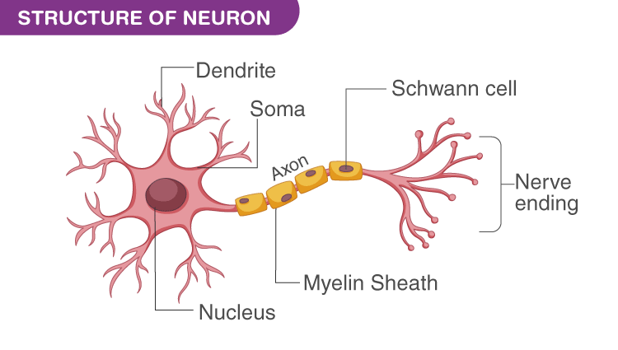
Perceptron history
Proposed by Frank Rosenblatt in 1957
Based on a model proposed by Warren McCulloch and Walter Pits in 1943
It follows the way
a simple neuron
works
Picture from: https://cdn1.byjus.com/wp-content/uploads/2020/02/STRUCTURE-OF-NEURON.png

Slide 5

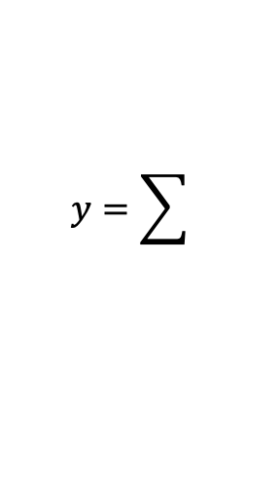

Perceptron Properties
  The idea is simple: a weighted sum over the inputs is compared to a threshold. If it greater than the threshold, than the neuron fires.
Input₁
weight₁
Input₂
weight₂
$$y=\sum{}$$
weight₃
$$y≥threshold$$
Input₃
weight_{n}
Input_{n}
$$y=\sum_{i=1}^{n}{{Input}_{i}×{weight}_{i}}, y≥threshold$$

Slide 6

Perceptron Properties
  Makes decisions by weighting up evidence
  Learning is performed by varying the weights and the threshold
$$output=\left\{\begin{aligned}1, if \sum_{i=0}^{n}{x_{i}w_{i}}>threshold \\ 0,if \sum_{i=0}^{n}{x_{i}w_{i}}≤threshold\end{aligned}\right.$$

Slide 7


Algorithm
A more mathematical way to see this, is with some vectors and a dot product.
The previous equation can be written in a different way (to avoid using the threshold as a separate value).
$$input= \left[\begin{aligned}{input}_{1} \\ {input}_{2} \\ ⋮ \\ {input}_{n}\end{aligned}\right], weight= \left[\begin{aligned}{weight}_{1} \\ {weight}_{2} \\ ⋮ \\ {weight}_{n}\end{aligned}\right], y=input∙weight, y≥threshold$$
$$input= \left[\begin{aligned}{input}_{1} \\ {input}_{2} \\ ⋮ \\ {input}_{n} \\ 1\end{aligned}\right], weight= \left[\begin{aligned}{weight}_{1} \\ {weight}_{2} \\ ⋮ \\ {weight}_{n} \\ −threshold\end{aligned}\right], y=input∙weight, y≥0$$

Slide 8

Algorithm
This form of the perceptron algorithm (that implies that a dot product must be bigger than 0) addresses the scenario with a binary label (a label can have two possible values – for example a label can indicate the presence or absence of a class).
Let’s write the perceptron equations for inputs with 2 elements:
$$input=\left[\begin{aligned}{input}_{1} \\ {input}_{2} \\ 1\end{aligned}\right], weight=\left[\begin{aligned}{weight}_{1} \\ {weight}_{2} \\ −threshold\end{aligned}\right], y=input∙weight,$$
$$result= {input}_{1}×{weight}_{1}+{input}_{2}×{weight}_{2}−threshold$$

Slide 9
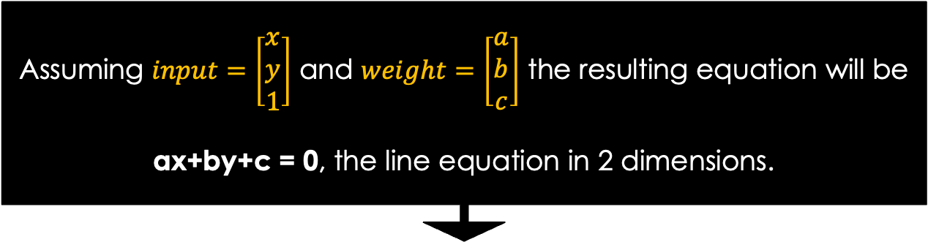
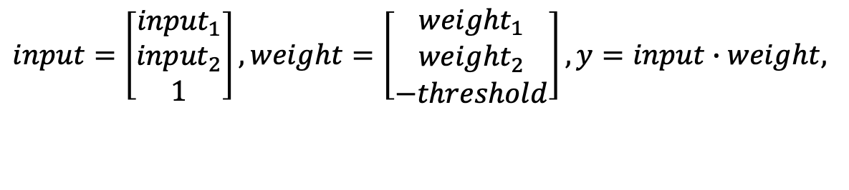
Algorithm
This form of the perceptron algorithm (that implies that a dot product must be bigger than 0) addresses the scenario with a binary label (a label can have two possible values – for example a label can indicate the presence or absence of a class).
Let’s write the perceptron equations for inputs with 2 elements:
Assuming $input=\left[\begin{aligned}x \\ y \\ 1\end{aligned}\right]$ and $weight=\left[\begin{aligned}a \\ b \\ c\end{aligned}\right]$ the resulting equation will be
ax+by+c = 0, the line equation in 2 dimensions.
$$input=\left[\begin{aligned}{input}_{1} \\ {input}_{2} \\ 1\end{aligned}\right], weight=\left[\begin{aligned}{weight}_{1} \\ {weight}_{2} \\ −threshold\end{aligned}\right], y=input∙weight,$$
$$result= {input}_{1}×{weight}_{1}+{input}_{2}×{weight}_{2}−threshold$$

Slide 10

Algorithm
This means that the perceptron algorithm models a hyper-plane equation in “n” dimensions. For 2 dimensions this is one of the forms of a line equation.
So … assuming we work on two dimension, the perceptron equation will be:
$$input=\left[\begin{aligned}x \\ y \\ 1\end{aligned}\right], weight=\left[\begin{aligned}a \\ b \\ c\end{aligned}\right],$$
$$input∙weight>0, or ax+by+c>0$$

Slide 11

Algorithm
To understand the meaning of the equation, lets consider the following line: $1∙x+\left(−4\right)∙y+3=0, a=1,b=−4,c=3$ as described in the below picture.
-9 -8 -7 -6 -5 -4 -3 -2 -1 0 +1 +2 +3 +4 +5 +6 +7 +8 +9
+4
+3
+2
+1
0
-1
-2
-3
-4

Slide 12
Algorithm
To understand the meaning of the equation, lets consider the following line: $1∙x+\left(−4\right)∙y+3=0, a=1,b=−4,c=3$ as described in the below picture.
-9 -8 -7 -6 -5 -4 -3 -2 -1 0 +1 +2 +3 +4 +5 +6 +7 +8 +9
+4
+3
+2
+1
0
-1
-2
-3
-4
Since “P” is located on the line, then
1∙(-3) + (-4)∙0 + 3 = 0
P(-3,0)

Slide 13
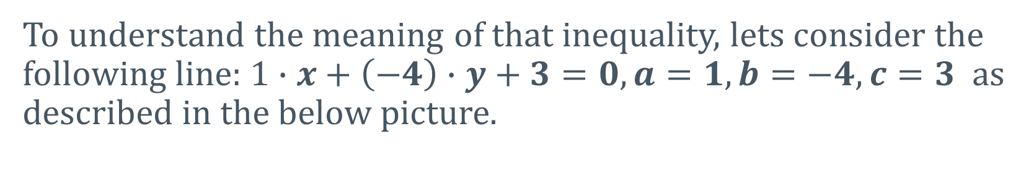
Algorithm
To understand the meaning of that inequality, lets consider the following line: $1∙x+\left(−4\right)∙y+3=0, a=1,b=−4,c=3$ as described in the below picture.
-9 -8 -7 -6 -5 -4 -3 -2 -1 0 +1 +2 +3 +4 +5 +6 +7 +8 +9
+4
+3
+2
+1
0
-1
-2
-3
-4
Since “P” is located on the line, then
1∙(-7) + (-4)∙(-1) + 3 = 0
P(-7,-1)

Slide 14

Algorithm
To understand the meaning of that the equation, lets consider the following line: $1∙x+\left(−4\right)∙y+3=0, a=1,b=−4,c=3$ as described in the below picture.
-9 -8 -7 -6 -5 -4 -3 -2 -1 0 +1 +2 +3 +4 +5 +6 +7 +8 +9
-16
-8
-4
-2
0
2
4
-3
-4
Since “P” is located on the line, then
1∙1 + (-4)∙1 + 3 = 0
P(1,1)

Slide 15
Algorithm
To understand the meaning of the equation, lets consider the following line: $1∙x+\left(−4\right)∙y+3=0, a=1,b=−4,c=3$ as described in the below picture.
-9 -8 -7 -6 -5 -4 -3 -2 -1 0 +1 +2 +3 +4 +5 +6 +7 +8 +9
+4
+3
+2
+1
0
-1
-2
-3
-4
In fact, for every point that resides on this line, the line equation (1x-4y+3) will always result in 0

Slide 16
Algorithm
To understand the meaning of the equation, lets consider the following line: $1∙x+\left(−4\right)∙y+3=0, a=1,b=−4,c=3$ as described in the below picture.
-9 -8 -7 -6 -5 -4 -3 -2 -1 0 +1 +2 +3 +4 +5 +6 +7 +8 +9
+4
+3
+2
+1
0
-1
-2
-3
-4
But what if point “P” is not on the line. In this case:
1∙(-6) + (-4)∙3 + 3 = -15
P(-6,3)

Slide 17
Algorithm
To understand the meaning of the equation, lets consider the following line: $1∙x+\left(−4\right)∙y+3=0, a=1,b=−4,c=3$ as described in the below picture.
-9 -8 -7 -6 -5 -4 -3 -2 -1 0 +1 +2 +3 +4 +5 +6 +7 +8 +9
+4
+3
+2
+1
0
-1
-2
-3
-4
But what if point “P” is not on the line. In this case:
1∙(-11) + (-4)∙0 + 3 = -8
P(-11,0)

Slide 18
Algorithm
To understand the meaning of the equation, lets consider the following line: $1∙x+\left(−4\right)∙y+3=0, a=1,b=−4,c=3$ as described in the below picture.
-9 -8 -7 -6 -5 -4 -3 -2 -1 0 +1 +2 +3 +4 +5 +6 +7 +8 +9
+4
+3
+2
+1
0
-1
-2
-3
-4
But what if point “P” is not on the line. In this case:
1∙(7) + (-4)∙(-3) + 3 = -2
P(7,3)

Slide 19
Algorithm
To understand the meaning of the equation, lets consider the following line: $1∙x+\left(−4\right)∙y+3=0, a=1,b=−4,c=3$ as described in the below picture.
-9 -8 -7 -6 -5 -4 -3 -2 -1 0 +1 +2 +3 +4 +5 +6 +7 +8 +9
+4
+3
+2
+1
0
-1
-2
-3
-4
We can say that for all points on this side of the line the equation (1x-4y+3) will always result in negative number

Slide 20
Algorithm
To understand the meaning of the equation, lets consider the following line: $1∙x+\left(−4\right)∙y+3=0, a=1,b=−4,c=3$ as described in the below picture.
-9 -8 -7 -6 -5 -4 -3 -2 -1 0 +1 +2 +3 +4 +5 +6 +7 +8 +9
+4
+3
+2
+1
0
-1
-2
-3
-4
P(-9,-3)
Now let's see some point on the other side of a line
1∙(-9) + (-4)∙(-3) + 3 = 6

Slide 21
Algorithm
To understand the meaning of the equation, lets consider the following line: $1∙x+\left(−4\right)∙y+3=0, a=1,b=−4,c=3$ as described in the below picture.
-9 -8 -7 -6 -5 -4 -3 -2 -1 0 +1 +2 +3 +4 +5 +6 +7 +8 +9
+4
+3
+2
+1
0
-1
-2
-3
-4
Now let's see some point on the other side of a line
1∙0 + (-4)∙0 + 3 = 3
P(0,0)

Slide 22
Algorithm
To understand the meaning of the equation, lets consider the following line: $1∙x+\left(−4\right)∙y+3=0, a=1,b=−4,c=3$ as described in the below picture.
-9 -8 -7 -6 -5 -4 -3 -2 -1 0 +1 +2 +3 +4 +5 +6 +7 +8 +9
+4
+3
+2
+1
0
-1
-2
-3
-4
Similarly, every point from the other side of the line , when testing them against the equation (1x-4y+3) will always result in a positive number

Slide 23
Algorithm
This means that the hyper-plane equation can used to separate points (some on one side that result in a positive value, and the other one on the other side that result in a negative value).
-9 -8 -7 -6 -5 -4 -3 -2 -1 0 +1 +2 +3 +4 +5 +6 +7 +8 +9
+4
+3
+2
+1
0
-1
-2
-3
-4

Slide 24
Algorithm
It is important to understand that the assignment of those two zones (red and green) is dictated by how we want to interpret the label with value 1. We can consider that:
  the class we are trying to classify corresponds to label 1, and everything else has the label -1
  the class we are trying to classify corresponds to label -1, and everything else has the label 1

Slide 25
Algorithm
So, the perceptron algorithm can be described as follows: given dataset, single class, labeled, can we find a hyperplane that separates all example of one class from the other ones ? (in the case below – can we separate the magenta points from the blue ones ?)
-9 -8 -7 -6 -5 -4 -3 -2 -1 0 +1 +2 +3 +4 +5 +6 +7 +8 +9
+4
+3
+2
+1
0
-1
-2
-3
-4

Slide 26
Algorithm
In practice, data sets are not always linear-separable. In this case, the purpose is to find a hyper-plane that minimizes or maximizes one of the metrics (FPR, ACC, etc).
-9 -8 -7 -6 -5 -4 -3 -2 -1 0 +1 +2 +3 +4 +5 +6 +7 +8 +9
+4
+3
+2
+1
0
-1
-2
-3
-4

Slide 27
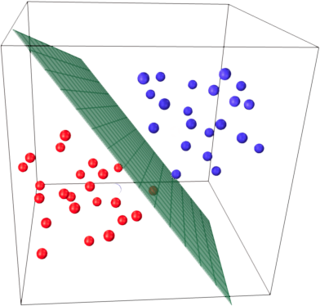
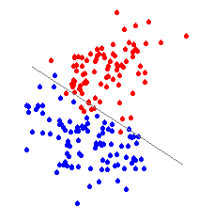
Algorithm
  The perceptron is also called a linear classifier since it is defined by a linear equation.
  In a 2 dimensional space, the perceptron is described as a line. In a space with 3 or more dimensions it is described as a hyperplane

Slide 28

Algorithm
  The coefficients (weights) define a normal vector, that we can consider a unit vector (length 1)
  The bias defines the distance from the origin to the plane
  The dot product will be equal to |b|, for every point located on the plane
      Will be less than |b| for every point located under the plane
      Will be grater than |b| for every point located above b
$$x∙w$$
b
w

Slide 29
Training

Slide 30
Training
At this point, we know that the perceptron algorithm is meant to search for a hyper-plane that can separate two data sets (as best of possible).
Let’s assume that we have the following dataset (for training):
Entry | Input₁ | Input₂ | … | Input_{n} | Label
#1 | I_{(1,1)} | I_{(1,2)} |  | I_{(1,n)} | YES
#2 | I_{(2,1)} | I_{(2,2)} |  | I_{(2,n)} | NO
…
#m | I_{(m,1)} | I_{(m,2)} |  | I_{(m,n)} | YES

Slide 31
Training
At this point, we know that the perceptron algorithm is meant to search for a hyper-plane that can separate two data sets (as best of possible).
Let’s assume that we have the following dataset (for training):
Entry | Input₁ | Input₂ | … | Input_{n} | Label
#1 | I_{(1,1)} | I_{(1,2)} |  | I_{(1,n)} | YES
#2 | I_{(2,1)} | I_{(2,2)} |  | I_{(2,n)} | NO
…
#m | I_{(m,1)} | I_{(m,2)} |  | I_{(m,n)} | YES
These are scalar values that represent the data associated with a particular entry. We can say that these could be considered coordinates in a “n” dimensional space
Coordinate on dimension 1
Coordinate on dimension 2
Coordinate on dimension n

Slide 32
Training
At this point, we know that the perceptron algorithm is meant to search for a hyper-plane that can separate two data sets (as best of possible).
Let’s assume that we have the following dataset (for training):
Entry | Input₁ | Input₂ | … | Input_{n} | Label
#1 | I_{(1,1)} | I_{(1,2)} |  | I_{(1,n)} | YES
#2 | I_{(2,1)} | I_{(2,2)} |  | I_{(2,n)} | NO
…
#m | I_{(m,1)} | I_{(m,2)} |  | I_{(m,n)} | YES
The label could be anything:
Yes/No or True/False (to reflect that the sample belongs or not to the class)
A string that reflects the name of the class and another one that reflects the rest (e.g. CAT and OTHERS) or (CLASS-A and CLASS-B)
Some numerical values (1/0)

Slide 33
Training
At this point, we know that the perceptron algorithm is meant to search for a hyper-plane that can separate two data sets (as best of possible).
Let’s assume that we have the following dataset (for training):
Entry | Input₁ | Input₂ | … | Input_{n} | Label
#1 | I_{(1,1)} | I_{(1,2)} |  | I_{(1,n)} | YES
#2 | I_{(2,1)} | I_{(2,2)} |  | I_{(2,n)} | NO
…
#m | I_{(m,1)} | I_{(m,2)} |  | I_{(m,n)} | YES
The target is to find a hyper-plane equation / or a vector “w=[w₁,w₂…w_{n}]” and a threshold that will classify most (if not all) of the samples from the dataset that are labeled with YES on one side of the hyperplane and most (if not all) of the samples from the dataset that are labeled with NO to the other side.

Slide 34

Training
Assuming we have the following dataset (for training):
Entry | Input₁ | Input₂ | … | Input_{n} | Label
#1 | I_{(1,1)} | I_{(1,2)} |  | I_{(1,n)} | NO
…
#k | I_{(k,1)} | I_{(k,2)} |  | I_{(k,n)} | YES
…
#m | I_{(m,1)} | I_{(m,2)} |  | I_{(m,n)} | YES
Entry | Input₁ | Input₂ | … | Input_{n} | Input_{n+1} | Label
#1 | I_{(1,1)} | I_{(1,2)} |  | I_{(1,n)} | 1 | NO
…
#k | I_{(k,1)} | I_{(k,2)} |  | I_{(k,n)} | 1 | YES
…
#m | I_{(m,1)} | I_{(m,2)} |  | I_{(m,n)} | 1 | YES
$$+ our model w=\left[\begin{matrix}w_{1} & ⋯ & w_{n}\end{matrix}\right] and threshold$$
$$+ our model w=\left[\begin{matrix}w_{1} & ⋯ & w_{n+1}\end{matrix}\right]$$
No need for threshold (column Input_{n+1})

Slide 35


Training
Assuming we have the following dataset (for training):
Entry | Input₁ | Input₂ | … | Input_{n} | Label
#1 | I_{(1,1)} | I_{(1,2)} |  | I_{(1,n)} | NO
…
#k | I_{(k,1)} | I_{(k,2)} |  | I_{(k,n)} | YES
…
#m | I_{(m,1)} | I_{(m,2)} |  | I_{(m,n)} | YES
Entry | Input₁ | Input₂ | … | Input_{n} | Input_{n+1} | Label
#1 | I_{(1,1)} | I_{(1,2)} |  | I_{(1,n)} | 1 | NO
…
#k | I_{(k,1)} | I_{(k,2)} |  | I_{(k,n)} | 1 | YES
…
#m | I_{(m,1)} | I_{(m,2)} |  | I_{(m,n)} | 1 | YES
$$+ our model w=\left[\begin{matrix}w_{1} & ⋯ & w_{n}\end{matrix}\right] and threshold$$
$$+ our model w=\left[\begin{matrix}w_{1} & ⋯ & w_{n+1}\end{matrix}\right]$$
No need for threshold (column Input_{n+1})
$$g\left(k\right)=\sum_{i=1}^{n}{\left(w_{i}×I_{\left(k,i\right)}\right)+threshold}$$
$$g\left(k\right)=\sum_{i=1}^{n+1}{\left(w_{i}×I_{\left(k,i\right)}\right)=w∙I_{k}}$$

Slide 36

Training
Assuming we have the following dataset (for training):
Entry | Input₁ | Input₂ | … | Input_{n} | Label
#1 | I_{(1,1)} | I_{(1,2)} |  | I_{(1,n)} | NO
…
#k | I_{(k,1)} | I_{(k,2)} |  | I_{(k,n)} | YES
…
#m | I_{(m,1)} | I_{(m,2)} |  | I_{(m,n)} | YES
Entry | Input₁ | Input₂ | … | Input_{n} | Input_{n+1} | Label
#1 | I_{(1,1)} | I_{(1,2)} |  | I_{(1,n)} | 1 | NO
…
#k | I_{(k,1)} | I_{(k,2)} |  | I_{(k,n)} | 1 | YES
…
#m | I_{(m,1)} | I_{(m,2)} |  | I_{(m,n)} | 1 | YES
$$+ our model w=\left[\begin{matrix}w_{1} & ⋯ & w_{n}\end{matrix}\right] and threshold$$
$$+ our model w=\left[\begin{matrix}w_{1} & ⋯ & w_{n+1}\end{matrix}\right]$$
No need for threshold (column Input_{n+1})
$$g\left(k\right)=\sum_{i=1}^{n}{\left(w_{i}×I_{\left(k,i\right)}\right)+threshold}$$
$$g\left(k\right)=\sum_{i=1}^{n+1}{\left(w_{i}×I_{\left(k,i\right)}\right)=w∙I_{k}}$$
$$Classified\left(k\right)=\left\{\begin{aligned}\begin{matrix}true & g\left(k\right)>0, {Label}_{k}=YES\end{matrix} \\ \begin{matrix}true & g\left(k\right)≤0, {Label}_{k}=NO\end{matrix} \\ \begin{matrix}false & g\left(k\right)>0, {Label}_{k}=NO\end{matrix} \\ \begin{matrix}false & g\left(k\right)≤0, {Label}_{k}=YES\end{matrix}\end{aligned}\right.$$

Slide 37
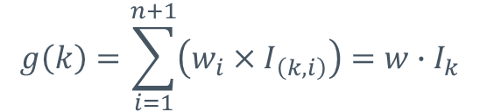
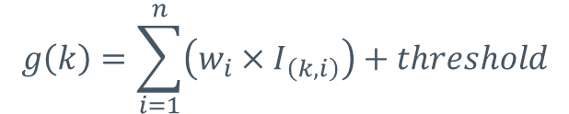
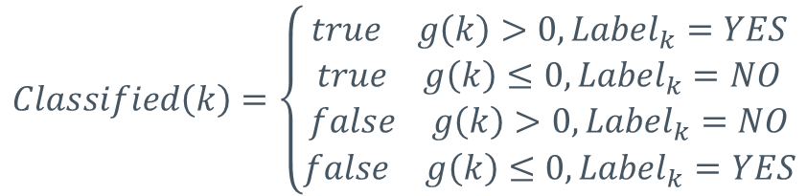
Training
Assuming we have the following dataset (for training):
Entry | Input₁ | Input₂ | … | Input_{n} | Label
#1 | I_{(1,1)} | I_{(1,2)} |  | I_{(1,n)} | NO
…
#k | I_{(k,1)} | I_{(k,2)} |  | I_{(k,n)} | YES
…
#m | I_{(m,1)} | I_{(m,2)} |  | I_{(m,n)} | YES
Entry | Input₁ | Input₂ | … | Input_{n} | Input_{n+1} | Label
#1 | I_{(1,1)} | I_{(1,2)} |  | I_{(1,n)} | 1 | NO
…
#k | I_{(k,1)} | I_{(k,2)} |  | I_{(k,n)} | 1 | YES
…
#m | I_{(m,1)} | I_{(m,2)} |  | I_{(m,n)} | 1 | YES
To simplify this equation, lets consider that all samples that are labeled YES are the ones that should be on the side of the hyper-plane where f(x) computes a positive value, and the ones labeled NO should be on the side of the hyperplane where f(x) computes a negative value.
$$+ our model w=\left[\begin{matrix}w_{1} & ⋯ & w_{n}\end{matrix}\right] and threshold$$
$$+ our model w=\left[\begin{matrix}w_{1} & ⋯ & w_{n+1}\end{matrix}\right]$$
No need for threshold (column Input_{n+1})
$$g\left(k\right)=\sum_{i=1}^{n}{\left(w_{i}×I_{\left(k,i\right)}\right)+threshold}$$
$$g\left(k\right)=\sum_{i=1}^{n+1}{\left(w_{i}×I_{\left(k,i\right)}\right)=w∙I_{k}}$$
We can change the labels as follows:
YES will be converted into 1, and NO will be converted into -1
$$Classified\left(k\right)=\left\{\begin{aligned}\begin{matrix}true & g\left(k\right)>0, {Label}_{k}=YES\end{matrix} \\ \begin{matrix}true & g\left(k\right)≤0, {Label}_{k}=NO\end{matrix} \\ \begin{matrix}false & g\left(k\right)>0, {Label}_{k}=NO\end{matrix} \\ \begin{matrix}false & g\left(k\right)≤0, {Label}_{k}=YES\end{matrix}\end{aligned}\right.$$

Slide 38
Training
Assuming we have the following dataset (for training):
Entry | Input₁ | Input₂ | … | Input_{n} | Label
#1 | I_{(1,1)} | I_{(1,2)} |  | I_{(1,n)} | NO (-1)
…
#k | I_{(k,1)} | I_{(k,2)} |  | I_{(k,n)} | YES (1)
…
#m | I_{(m,1)} | I_{(m,2)} |  | I_{(m,n)} | YES (1)
Entry | Input₁ | Input₂ | … | Input_{n} | Input_{n+1} | Label
#1 | I_{(1,1)} | I_{(1,2)} |  | I_{(1,n)} | 1 | NO (-1)
…
#k | I_{(k,1)} | I_{(k,2)} |  | I_{(k,n)} | 1 | YES (1)
…
#m | I_{(m,1)} | I_{(m,2)} |  | I_{(m,n)} | 1 | YES (1)
$$+ our model w=\left[\begin{matrix}w_{1} & ⋯ & w_{n}\end{matrix}\right] and threshold$$
$$+ our model w=\left[\begin{matrix}w_{1} & ⋯ & w_{n+1}\end{matrix}\right]$$
No need for threshold (column Input_{n+1})
We can change the labels as follows:
YES will be converted into 1, and NO will be converted into -1

Slide 39


Training
Assuming we have the following dataset (for training):
Entry | Input₁ | Input₂ | … | Input_{n} | Label
#1 | I_{(1,1)} | I_{(1,2)} |  | I_{(1,n)} | NO (-1)
…
#k | I_{(k,1)} | I_{(k,2)} |  | I_{(k,n)} | YES (1)
…
#m | I_{(m,1)} | I_{(m,2)} |  | I_{(m,n)} | YES (1)
Entry | Input₁ | Input₂ | … | Input_{n} | Input_{n+1} | Label
#1 | I_{(1,1)} | I_{(1,2)} |  | I_{(1,n)} | 1 | NO (-1)
…
#k | I_{(k,1)} | I_{(k,2)} |  | I_{(k,n)} | 1 | YES (1)
…
#m | I_{(m,1)} | I_{(m,2)} |  | I_{(m,n)} | 1 | YES (1)
$$+ our model w=\left[\begin{matrix}w_{1} & ⋯ & w_{n}\end{matrix}\right] and threshold$$
$$+ our model w=\left[\begin{matrix}w_{1} & ⋯ & w_{n+1}\end{matrix}\right]$$
No need for threshold (column Input_{n+1})
$$f\left(k\right)={Label}_{k}×\left(\sum_{i=1}^{n}{\left(w_{i}×I_{\left(k,i\right)}\right)+threshold}\right)$$
$$f\left(k\right)={Label}_{k}×\left(\sum_{i=1}^{n+1}{\left(w_{i}×I_{\left(k,i\right)}\right)}\right)$$
$={Label}_{k}×$ ($w∙I_{k}$)

Slide 40

Training
Assuming we have the following dataset (for training):
Entry | Input₁ | Input₂ | … | Input_{n} | Label
#1 | I_{(1,1)} | I_{(1,2)} |  | I_{(1,n)} | NO (-1)
…
#k | I_{(k,1)} | I_{(k,2)} |  | I_{(k,n)} | YES (1)
…
#m | I_{(m,1)} | I_{(m,2)} |  | I_{(m,n)} | YES (1)
Entry | Input₁ | Input₂ | … | Input_{n} | Input_{n+1} | Label
#1 | I_{(1,1)} | I_{(1,2)} |  | I_{(1,n)} | 1 | NO (-1)
…
#k | I_{(k,1)} | I_{(k,2)} |  | I_{(k,n)} | 1 | YES (1)
…
#m | I_{(m,1)} | I_{(m,2)} |  | I_{(m,n)} | 1 | YES (1)
$$+ our model w=\left[\begin{matrix}w_{1} & ⋯ & w_{n}\end{matrix}\right] and threshold$$
$$+ our model w=\left[\begin{matrix}w_{1} & ⋯ & w_{n+1}\end{matrix}\right]$$
No need for threshold (column Input_{n+1})
$$f\left(k\right)={Label}_{k}×\left(\sum_{i=1}^{n}{\left(w_{i}×I_{\left(k,i\right)}\right)+threshold}\right)$$
$$f\left(k\right)={Label}_{k}×\left(\sum_{i=1}^{n+1}{\left(w_{i}×I_{\left(k,i\right)}\right)}\right)$$
$={Label}_{k}×$ ($w∙I_{k}$)
$$Classified\left(k\right)=\left\{\begin{aligned}true, f\left(k\right)>0 \\ &false, f\left(k\right)≤0\end{aligned}\right.$$

Slide 41

Training
Once we know that a sample is incorrectly classified we can readjust the weight vector.
Let’s consider that sample “k” is not correctly classified:
In this cases, we need to :
compute an error
adjust the “w” vector with that error so that the next time we compute f(k) the result will be better than the previous one.
For this we introduce a learning rate termen ($α∈(0,1)$) (values like 0.01, or 0.1 are often used).
$$f\left(k\right)={Label}_{k}×\left(w∙I_{k}\right), f\left(k\right)≤0$$

Slide 42
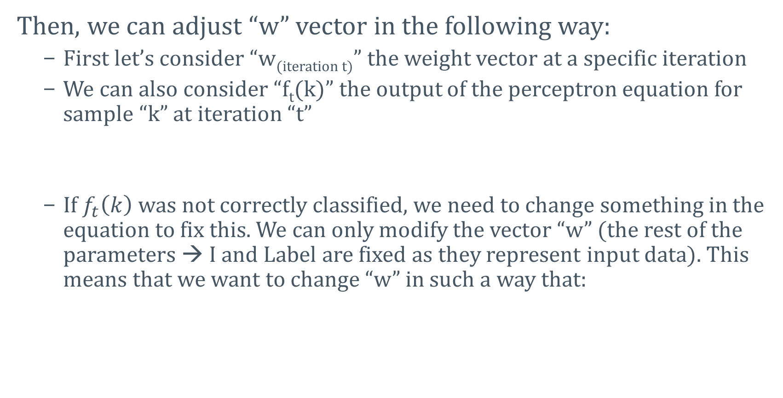
Training
Then, we can adjust “w” vector in the following way:
  First let’s consider “w_{(iteration t)}” the weight vector at a specific iteration
  We can also consider “f_{t}(k)” the output of the perceptron equation for sample “k” at iteration “t”
  If $f_{t}\left(k\right)$ was not correctly classified, we need to change something in the equation to fix this. We can only modify the vector “w” (the rest of the parameters → I and Label are fixed as they represent input data). This means that we want to change “w” in such a way that:
$$f_{t}\left(k\right)=w_{(iteration t)}∙I_{k}, with {{Label}_{k}×f}_{t}\left(k\right)≤0$$
$${{Label}_{k}×f}_{t}\left(k\right)>0$$

Slide 43


Training
So … our target is:
One way we can be certain of this is if can make each term of form: $w_{j}×I_{\left(k,j\right)}×{Label}_{k}$ to always be positive.
One solution to this equation is to make (in multiple steps) $w_{j}$to be equal to $I_{\left(k,j\right)}×{Label}_{k}$. At that point the previous term will be:
$${{Label}_{k}×f}_{t}\left(k\right)>0→{Label}_{k}×\sum_{j=1}^{n+1}{\left(w_{j}⋅I_{\left(k,j\right)}\right)}>0→\sum_{j=1}^{n+1}{\left(w_{j}⋅I_{\left(k,j\right)}×{Label}_{k}\right)}>0$$
$$I_{\left(k,j\right)}×{Label}_{k}×I_{\left(k,j\right)}×{Label}_{k}=I_{(k,j)}^{2}×{Label}_{k}^{2}=I_{(k,j)}^{2}×1$$

Slide 44

Training
The solution to the previous equation is to add a small portion of $I_{\left(k,j\right)}×{Label}_{k}$ into $w_{j}$ . Other solutions are to add a small portion of the following difference $I_{\left(k,j\right)}×{Label}_{k}−w_{j}$into $w_{j}$
This is where the learning rate ($α$ ) comes into place. Usually, $α$ is a small value with $0<α<1$ and it works like a percentage in this case.

Slide 45
Training
Then, we can adjust “w” vector in the following way:
  First let’s consider “w_{(iteration t)}” the weight vector at a specific iteration
  We can also consider “f_{t}(k)” the output of the perceptron equation for sample “k” at iteration “t”
  We can adjust the weight vector in the following way:
$$f_{t}\left(k\right)=\left(w_{(iteration t)}∙I_{k}\right),{{Label}_{k}×f}_{t}\left(k\right)≤0$$
$$w_{(iteration t+1)}=w_{(iteration t)}+I_{k}×{Label}_{k}×α$$

Slide 46
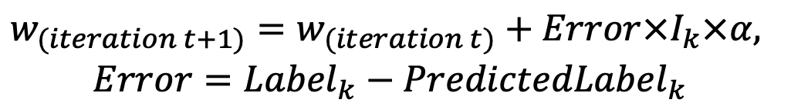
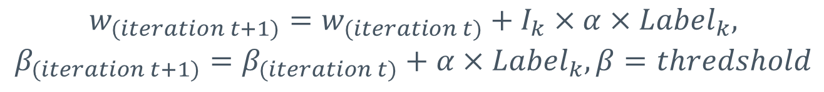
Training
As a general observation, the formula for adjusting the vector “w” can be written in different ways (but the logic is similar) – for the cases where these values need to be adjusted (the tested sample is not classified correctly) :
# | Formulas
1
2
3
$$w_{(iteration t+1)}=w_{(iteration t)}+I_{k}×α×{Label}_{k}$$
The bias (threshold) is included in the weights vector
(for cases 1 and 2)
$$w_{(iteration t+1)}=w_{(iteration t)}+{Error×I}_{k}×α,$$
$$Error={Label}_{k}−{PredictedLabel}_{k}$$
$$w_{(iteration t+1)}=w_{(iteration t)}+I_{k}×α×{Label}_{k},$$
$$β_{(iteration t+1)}=β_{(iteration t)}+α×{Label}_{k}, β=thredshold$$

Slide 47
Training
Let’s put all of these together and build a training algorithm:
Line | Pseudocode
1 | w ← a vector of “n+1” elements initialized randomly or with 0
2 | trainset ← the training set
3 | α ← 0.01 // learning rate
4 | repeat
5 | foreach sample in trainset
6 | classified ← (sample.label x dotproduct(sample.input,w)) > 0
7 | if classified then continue
8 | w ← w + sample.input x α x sample.label
9 | end foreach
10 | until exit_condition

Slide 48
Training
Let’s put all of these together and build a training algorithm:
Line | Pseudocode
1 | w ← a vector of “n+1” elements initialized randomly or with 0
2 | trainset ← the training set
3 | α ← 0.01 // learning rate
4 | repeat
5 | foreach sample in trainset
6 | classified ← (sample.label x dotproduct(sample.input,w)) > 0
7 | if classified then continue
8 | w ← w + sample.input x α x sample.label
9 | end foreach
10 | until exit_condition
classified is a Boolean value that will be true if the result is (>0) and false otherwise.

Slide 49
Training
Let’s put all of these together and build a training algorithm:
Line | Pseudocode
1 | w ← a vector of “n+1” elements initialized randomly or with 0
2 | trainset ← the training set
3 | α ← 0.01 // learning rate
4 | repeat
5 | foreach sample in trainset
6 | classified ← (sample.label x dotproduct(sample.input,w)) > 0
7 | if classified then continue
8 | w ← w + sample.input x α x sample.label
9 | end foreach
10 | until exit_condition
Exit condition can be several things:
A number of iterations (epochs) is achieved
Every sample is correctly classified
A specific metric is achieved (e.g. FPR < 3%, ACC > 99%, etc)

Slide 50
Training
Let’s put all of these together and build a training algorithm:
Line | Pseudocode
1 | w ← a vector of “n+1” elements initialized randomly or with 0
2 | trainset ← the training set
3 | α ← 0.01 // learning rate
4 | repeat
5 | foreach sample in trainset
6 | classified ← (sample.label x dotproduct(sample.input,w)) > 0
7 | if classified then continue
8 | w ← w + sample.input x α x sample.label
9 | end foreach
10 | until exit_condition
If threshold (β) is being used, then this equation below changes into:
w ← w + sample.input x α x sample.label
β ← β + α x sample.label

Slide 51
Example

Slide 52
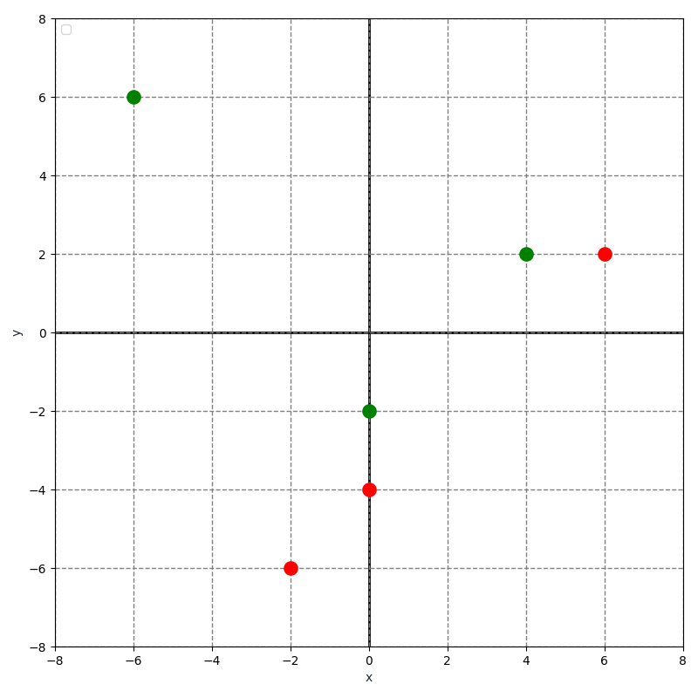
Demo
1. Let’s consider the following training dataset that consists in points in a two dimensional plane:
Entry | Input₁ (X) | Input₂ (Y) | Label (Color)
#1 | 4 | 2 | 1 (■)
#2 | -6 | 6 | 1 (■)
#3 | 0 | -2 | 1 (■)
#4 | 0 | -4 | -1 (■)
#5 | -2 | -6 | -1 (■)
#6 | 6 | 2 | -1 (■)

Slide 53
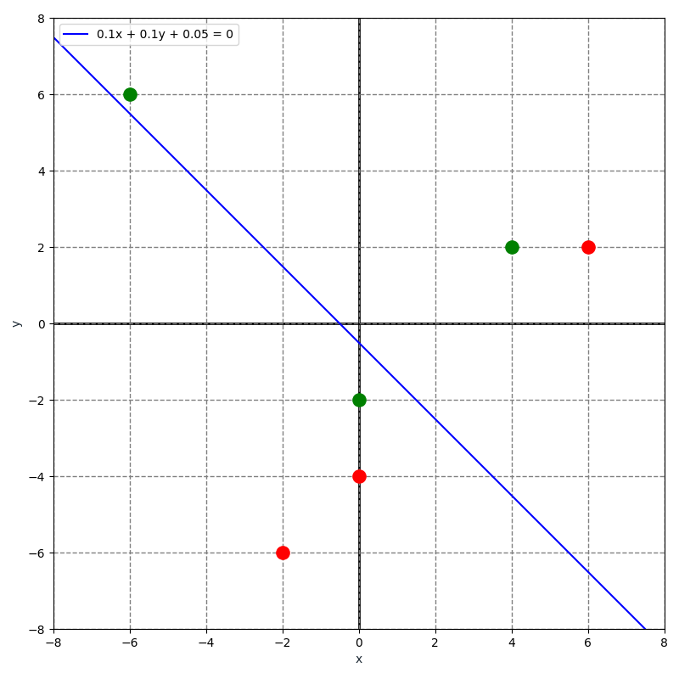
Demo
2. Now let’s create a weight vector initialized with random (small values) and a threshold (β)
Entry | Input₁ (X) | Input₂ (Y) | Label (Color)
#1 | 4 | 2 | 1 (■)
#2 | -6 | 6 | 1 (■)
#3 | 0 | -2 | 1 (■)
#4 | 0 | -4 | -1 (■)
#5 | -2 | -6 | -1 (■)
#6 | 6 | 2 | -1 (■)
This blue line is the graphical representation of the model (the weight vector and threshold).
0.1x + 0.1y + 0.05 = 0
Weight₁ | Weight₂ | Threshold (β)
0.1 | 0.1 | 0.05

Slide 54
Demo
3. Let’s also consider the learning rate (α) as 0.02
Entry | Input₁ (X) | Input₂ (Y) | Label (Color)
#1 | 4 | 2 | 1 (■)
#2 | -6 | 6 | 1 (■)
#3 | 0 | -2 | 1 (■)
#4 | 0 | -4 | -1 (■)
#5 | -2 | -6 | -1 (■)
#6 | 6 | 2 | -1 (■)
Weight₁ | Weight₂ | Threshold (β)
0.1 | 0.1 | 0.05

Slide 55
Demo
4. For the training part, we will check each entry and see if it is correctly classified. If not, we will adjust the weight vector.
Entry | Input₁ (X) | Input₂ (Y) | Label (Color)
#1 | 4 | 2 | 1 (■)
#2 | -6 | 6 | 1 (■)
#3 | 0 | -2 | 1 (■)
#4 | 0 | -4 | -1 (■)
#5 | -2 | -6 | -1 (■)
#6 | 6 | 2 | -1 (■)
Notice that the samples are sorted (first the ones with label 1 and then the ones with label -1). In practice it is best to shuffle them.
Weight₁ | Weight₂ | Threshold (β)
0.1 | 0.1 | 0.05

Slide 56
Demo
5. Testing each entry (from 1 to 6) against the current model.
Entry | Input₁ (X) | Input₂ (Y) | Label (Color)
#1 | 4 | 2 | 1 (■)
#2 | -6 | 6 | 1 (■)
#3 | 0 | -2 | 1 (■)
#4 | 0 | -4 | -1 (■)
#5 | -2 | -6 | -1 (■)
#6 | 6 | 2 | -1 (■)
This point is correctly classified (is on the right side of the hyper-plane). As such, we don’t have to do anything,
Weight₁ | Weight₂ | Threshold (β)
0.1 | 0.1 | 0.05

Slide 57
Demo
5. Testing each entry (from 1 to 6) against the current model.
Entry | Input₁ (X) | Input₂ (Y) | Label (Color)
#1 | 4 | 2 | 1 (■)
#2 | -6 | 6 | 1 (■)
#3 | 0 | -2 | 1 (■)
#4 | 0 | -4 | -1 (■)
#5 | -2 | -6 | -1 (■)
#6 | 6 | 2 | -1 (■)
Similar situation as with entry #1. This point is also correctly classified (its label is green, and it resides on the green part of the hyperplane).
As such, we don’t need to do anything to change the hyper-plane.
Weight₁ | Weight₂ | Threshold (β)
0.1 | 0.1 | 0.05

Slide 58
Demo
5. Testing each entry (from 1 to 6) against the current model.
Entry | Input₁ (X) | Input₂ (Y) | Label (Color)
#1 | 4 | 2 | 1 (■)
#2 | -6 | 6 | 1 (■)
#3 | 0 | -2 | 1 (■)
#4 | 0 | -4 | -1 (■)
#5 | -2 | -6 | -1 (■)
#6 | 6 | 2 | -1 (■)
This point however is not correctly classified (it does not reside on right part of the hyper-plan) and as such we will have to adjust the hyper plane
Weight₁ | Weight₂ | Threshold (β)
0.1 | 0.1 | 0.05

Slide 59
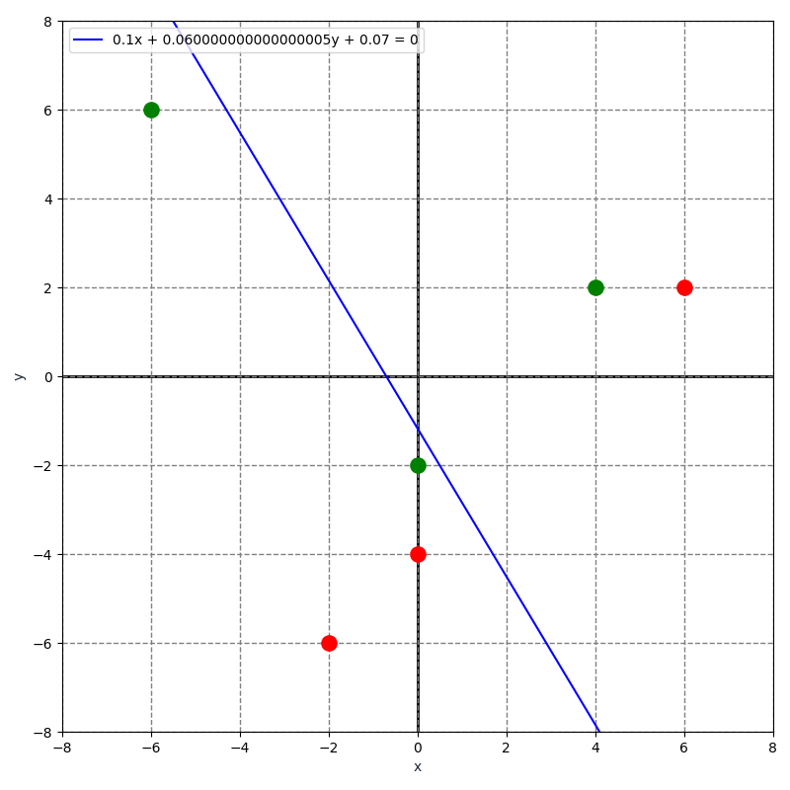

Demo
5. Testing each entry (from 1 to 6) against the current model.
Entry | Input₁ (X) | Input₂ (Y) | Label (Color)
#1 | 4 | 2 | 1 (■)
#2 | -6 | 6 | 1 (■)
#3 | 0 | -2 | 1 (■)
#4 | 0 | -4 | -1 (■)
#5 | -2 | -6 | -1 (■)
#6 | 6 | 2 | -1 (■)
We will change vector “w” and threshold β as follows:
$$w=w+{Entry}_{3}.Input×{Entry}_{3}.Label×α=\left[\begin{aligned}0.1 \\ 0.1\end{aligned}\right]+\left[\begin{aligned}0 \\ −2\end{aligned}\right]×1×0.02=\left[\begin{aligned}0.1 \\ 0.1\end{aligned}\right]+\left[\begin{aligned}0 \\ −0.04\end{aligned}\right]=\left[\begin{aligned}0.1 \\ 0.06\end{aligned}\right],$$
$$β=β+{Entry}_{3}.Label×α=0.05+1×0.02=0.07$$
Weight₁ | Weight₂ | Threshold (β)
0.1 | 0.06 | 0.07

Slide 60
Demo
5. Testing each entry (from 1 to 6) against the current model.
Entry | Input₁ (X) | Input₂ (Y) | Label (Color)
#1 | 4 | 2 | 1 (■)
#2 | -6 | 6 | 1 (■)
#3 | 0 | -2 | 1 (■)
#4 | 0 | -4 | -1 (■)
#5 | -2 | -6 | -1 (■)
#6 | 6 | 2 | -1 (■)
This point is correctly classified (it has the color red and it is on the red side of the hyper-plane)
Weight₁ | Weight₂ | Threshold (β)
0.1 | 0.06 | 0.07

Slide 61
Demo
5. Testing each entry (from 1 to 6) against the current model.
Entry | Input₁ (X) | Input₂ (Y) | Label (Color)
#1 | 4 | 2 | 1 (■)
#2 | -6 | 6 | 1 (■)
#3 | 0 | -2 | 1 (■)
#4 | 0 | -4 | -1 (■)
#5 | -2 | -6 | -1 (■)
#6 | 6 | 2 | -1 (■)
This point is correctly classified (it has the color red and it is on the red side of the hyper-plane)
Weight₁ | Weight₂ | Threshold (β)
0.1 | 0.06 | 0.07

Slide 62
Demo
5. Testing each entry (from 1 to 6) against the current model.
Entry | Input₁ (X) | Input₂ (Y) | Label (Color)
#1 | 4 | 2 | 1 (■)
#2 | -6 | 6 | 1 (■)
#3 | 0 | -2 | 1 (■)
#4 | 0 | -4 | -1 (■)
#5 | -2 | -6 | -1 (■)
#6 | 6 | 2 | -1 (■)
This point however is not correctly classified (it does not reside on right part of the hyper-plan) and as such we will have to adjust the hyper plane
Weight₁ | Weight₂ | Threshold (β)
0.1 | 0.06 | 0.07

Slide 63
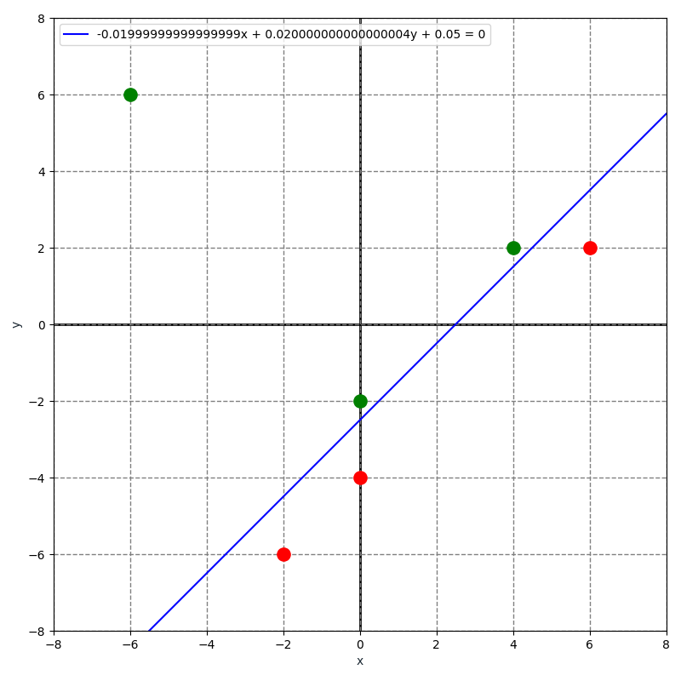

Demo
5. Testing each entry (from 1 to 6) against the current model.
Entry | Input₁ (X) | Input₂ (Y) | Label (Color)
#1 | 4 | 2 | 1 (■)
#2 | -6 | 6 | 1 (■)
#3 | 0 | -2 | 1 (■)
#4 | 0 | -4 | -1 (■)
#5 | -2 | -6 | -1 (■)
#6 | 6 | 2 | -1 (■)
We will change vector “w” and threshold β as follows:
$$w=w+{Entry}_{6}.Input×{Entry}_{6}.Label×α=\left[\begin{aligned}0.1 \\ 0.06\end{aligned}\right]+\left[\begin{aligned}6 \\ 2\end{aligned}\right]×−1×0.02=\left[\begin{aligned}0.1 \\ 0.01\end{aligned}\right]+\left[\begin{aligned}−0.12 \\ −0.04\end{aligned}\right]=\left[\begin{aligned}−0.02 \\ 0.02\end{aligned}\right],$$
$$β=β+{Entry}_{6}.Label×α=0.07+(−1)×0.02=0.05$$
Weight₁ | Weight₂ | Threshold (β)
-0.02 | 0.02 | 0.05

Slide 64
Demo
5. Testing each entry (from 1 to 6) against the current model.
Entry | Input₁ (X) | Input₂ (Y) | Label (Color)
#1 | 4 | 2 | 1 (■)
#2 | -6 | 6 | 1 (■)
#3 | 0 | -2 | 1 (■)
#4 | 0 | -4 | -1 (■)
#5 | -2 | -6 | -1 (■)
#6 | 6 | 2 | -1 (■)
Notice that at this point we have found a hyper-plane that separates all green dots from the red ones. At this point we can stop the algorithm.
Weight₁ | Weight₂ | Threshold (β)
-0.02 | 0.02 | 0.05

Slide 65
Batch training

Slide 66
Batch training
Let’s consider the previous example, but with different arrangements of the order of the elements in the dataset.
# | Input₁ | Input₂ | Label
#1 | 4 | 2 | 1 (■)
#2 | -6 | 6 | 1 (■)
#3 | 0 | -2 | 1 (■)
#4 | 0 | -4 | -1 (■)
#5 | -2 | -6 | -1 (■)
#6 | 6 | 2 | -1 (■)
# | Input₁ | Input₂ | Label
#1 | 4 | 2 | 1 (■)
#5 | -2 | -6 | -1 (■)
#3 | 0 | -2 | 1 (■)
#2 | -6 | 6 | 1 (■)
#4 | 0 | -4 | -1 (■)
#6 | 6 | 2 | -1 (■)
# | Input₁ | Input₂ | Label
#3 | 0 | -2 | 1 (■)
#2 | -6 | 6 | 1 (■)
#6 | 6 | 2 | -1 (■)
#5 | -2 | -6 | -1 (■)
#1 | 4 | 2 | 1 (■)
#4 | 0 | -4 | -1 (■)
# | Input₁ | Input₂ | Label
#5 | -2 | -6 | -1 (■)
#3 | 0 | -2 | 1 (■)
#2 | -6 | 6 | 1 (■)
#1 | 4 | 2 | 1 (■)
#6 | 6 | 2 | -1 (■)
#4 | 0 | -4 | -1 (■)
All of these databases contain the same entries just organized in different order. As such, the training will be different for each case. All of these cases will eventually reach a point where the hyperplane separates all green and red dots. For each case we will record how many iterations (epochs) it takes to find the best hyperplane, and how many changes to the original weight vector it takes.

Slide 67
Batch training
Let’s consider the previous example, but with different arrangements of the order of the elements in the dataset.
# | Input₁ | Input₂ | Label
#1 | 4 | 2 | 1 (■)
#2 | -6 | 6 | 1 (■)
#3 | 0 | -2 | 1 (■)
#4 | 0 | -4 | -1 (■)
#5 | -2 | -6 | -1 (■)
#6 | 6 | 2 | -1 (■)
# | Input₁ | Input₂ | Label
#1 | 4 | 2 | 1 (■)
#5 | -2 | -6 | -1 (■)
#3 | 0 | -2 | 1 (■)
#2 | -6 | 6 | 1 (■)
#4 | 0 | -4 | -1 (■)
#6 | 6 | 2 | -1 (■)
# | Input₁ | Input₂ | Label
#3 | 0 | -2 | 1 (■)
#2 | -6 | 6 | 1 (■)
#6 | 6 | 2 | -1 (■)
#5 | -2 | -6 | -1 (■)
#1 | 4 | 2 | 1 (■)
#4 | 0 | -4 | -1 (■)
# | Input₁ | Input₂ | Label
#5 | -2 | -6 | -1 (■)
#3 | 0 | -2 | 1 (■)
#2 | -6 | 6 | 1 (■)
#1 | 4 | 2 | 1 (■)
#6 | 6 | 2 | -1 (■)
#4 | 0 | -4 | -1 (■)
Epochs=2,Changes=4
Epochs=5,Changes=15
Epochs=9,Changes=22
Epochs=10,Changes=28
As seen, different shuffles of the same database produce different results.

Slide 68

Batch training
Considering that:
  At sample “t” from the training we have a “w_{t}” and that we need to change it because it is not correctly classified
  Then at sample “t+1” we will have:
  This means that the way current algorithm is, we can not know in advance what is the value of w_{t+1} unless we have already computed w_{t}. Furthermore, because of this, we can not parallelize the algorithm.
$$w_{(t+1)}=w_{(t)}+I_{t+1}×α×{Label}_{t+1}$$

Slide 69
Batch training
Let’s write the original algorithm (this time using threshold):
Line | Pseudocode
1 | w ← a vector of “n” elements initialized randomly or with 0
2 | trainset ← the training set
3 | α ← 0.01 // learning rate
4 | β ← a random value or 0
5 | repeat
6 | foreach sample in trainset
7 | classified ← (sample.label x (dotproduct(sample.input,w) + β))>0
8 | if classified then continue
9 | w ← w + sample.input x α x sample.label
10 | β ← β + α x sample.label
11 | end foreach
12 | until exit_condition

Slide 70
Batch training
Now let’s see how we can modify it to work with a batch:
Line | Pseudocode
1 | w ← a vector of “n” elements initialized randomly or with 0
2 | trainset ← the training set
3 | α ← 0.01 // learning rate
4 | β ← a random value or 0
5 | repeat
6 | Δ ← a vector filled with 0 (zeros) of size “n”
7 | Β ← 0 // a temporary threshold
8 | foreach sample in trainset
9 | classified ← (sample.label x (dotproduct(sample.input,w) + β))>0
10 | if classified then continue
11 | Δ ← Δ + sample.input x α x sample.label
12 | Β ← Β + α x sample.label
13 | end foreach
14 | w ← w + Δ
15 | β ← β + Β
16 | until exit_condition

Slide 71
Batch training
Now let’s see how we can modify it to work with a batch:
Line | Pseudocode
1 | w ← a vector of “n” elements initialized randomly or with 0
2 | trainset ← the training set
3 | α ← 0.01 // learning rate
4 | β ← a random value or 0
5 | repeat
6 | Δ ← a vector filled with 0 (zeros) of size “n”
7 | Β ← 0 // a temporary threshold
8 | foreach sample in trainset
9 | classified ← positive(sample.label x (dotproduct(sample.input,w) + β))>0
10 | if classified then continue
11 | Δ ← Δ + sample.input x α x sample.label
12 | Β ← Β + α x sample.label
13 | end foreach
14 | w ← w + Δ
15 | β ← β + Β
16 | until exit_condition
Notice that we have introduced 2 new variables
(Δ and Β) both of them initialized with 0. They store the relative change that needs to be applied to the hyperplane.

Slide 72
Batch training
Now let’s see how we can modify it to work with a batch:
Line | Pseudocode
1 | w ← a vector of “n” elements initialized randomly or with 0
2 | trainset ← the training set
3 | α ← 0.01 // learning rate
4 | β ← a random value or 0
5 | repeat
6 | Δ ← a vector filled with 0 (zeros) of size “n”
7 | Β ← 0 // a temporary threshold
8 | foreach sample in trainset
9 | classified ← (sample.label x (dotproduct(sample.input,w) + β))>0
10 | if classified then continue
11 | Δ ← Δ + sample.input x α x sample.label
12 | Β ← Β + α x sample.label
13 | end foreach
14 | w ← w + Δ
15 | β ← β + Β
16 | until exit_condition
For every sample, we check it against the current hyper-plane (w and β). If the sample is not correctly classified, we modify the new parameters instead of the hyperplane. This makes the process be invariant to sample order.

Slide 73
Batch training
Now let’s see how we can modify it to work with a batch:
Line | Pseudocode
1 | w ← a vector of “n” elements initialized randomly or with 0
2 | trainset ← the training set
3 | α ← 0.01 // learning rate
4 | β ← a random value or 0
5 | repeat
6 | Δ ← a vector filled with 0 (zeros) of size “n”
7 | Β ← 0 // a temporary threshold
8 | foreach sample in trainset
9 | classified ← positive(sample.label x (dotproduct(sample.input,w) + β))>0
10 | if classified then continue
11 | Δ ← Δ + sample.input x α x sample.label
12 | Β ← Β + α x sample.label
13 | end foreach
14 | w ← w + Δ
15 | β ← β + Β
16 | until exit_condition
Finally, after every sample from the training set has been validated against the current hyperplane and we have computed the differences from all samples, we adjust the hyperplane and resume the process.

Slide 74
Batch training
Now let’s see how we can modify it to work with a batch:
Line | Pseudocode
1 | w ← a vector of “n” elements initialized randomly or with 0
2 | trainset ← the training set
3 | α ← 0.01 // learning rate
4 | β ← a random value or 0
5 | repeat
6 | Δ ← a vector filled with 0 (zeros) of size “n”
7 | Β ← 0 // a temporary threshold
8 | foreach sample in trainset
9 | classified ← (sample.label x (dotproduct(sample.input,w) + β))>0
10 | if classified then continue
11 | Δ ← Δ + sample.input x α x sample.label
12 | Β ← Β + α x sample.label
13 | end foreach
14 | w ← w + Δ
15 | β ← β + Β
16 | until exit_condition
To simplify the process, let’s consider the following code as a separate function defined as follows:
train(trainingSet, weights, beta) → (Δ, Β)

Slide 75
Batch training
This is how the train function looks like:
Line | Train function:
1 | function train(trainset, w, β)
2 | α ← 0.01 // learning rate
3 | Δ ← a vector filled with 0 (zeros) of same size of w
4 | Β ← 0 // a temporary threshold
5 | foreach sample in trainset
6 | classified ← (sample.label x (dotproduct(sample.input,w) + β))>0
7 | if classified then continue
8 | Δ ← Δ + sample.input x α x sample.label
9 | Β ← Β + α x sample.label
10 | end foreach
11 | return (Δ, Β)
12 | end function

Slide 76
Batch training
With this in mind we can modify the original algorithm as follows:
Now that we have changed the code in this way we can do some other things as well:
  Mini batch
  Parallel training
Line | Pseudocode
1 | w ← a vector of “n” elements initialized randomly or with 0
2 | trainset ← the training set
3 | α ← 0.01 // learning rate
4 | β ← a random value or 0
5 | repeat
6 | Δ, Β ← train (trainset, w, β)
7 | w ← w + Δ
8 | β ← β + Β
9 | until exit_condition

Slide 77
Batch training
Let’s consider the following functions:
split(sampleset, number) → this method splits the sample set into multiple (disjunctive) sample sets provided by the parameter number. For example, assuming:
  Sample set has 100 entries
  We want to split in 4 batches
  We will call split(sampleset,4). This will result in 4 sample sets: one that contains the first 25 entries, the second one that contains the entries from index 26 to index 50, and so on.
thread::run(command) → this will execute a specific command but on a different thread

Slide 78
Batch training
A parallel processing will look like this:
Line | Pseudocode
1 | w ← a vector of “n” elements initialized randomly or with 0
2 | trainset ← the training set
3 | α ← 0.01 // learning rate
4 | β ← a random value or 0
5 | batches ← split (trainset, number_of_threads)
6 | repeat
7 | for index in 0..len(batches)
8 | Δ_{index}, Β_{index} ← thread::run(train (batches[index], w, β))
9 | end for
10 | wait for all threads to finish
11 | for index in 0..len(batches)
12 | w ← w + Δ_{index}
13 | β ← β + Β_{index}
14 | end for
15 | until exit_condition

Slide 79
Batch training
A mini-batch consists in the following:
Line | Pseudocode
1 | w ← a vector of “n” elements initialized randomly or with 0
2 | trainset ← the training set
3 | α ← 0.01 // learning rate
4 | β ← a random value or 0
5 | batches ← split (trainset, nr_of_batches)
5 | repeat
6 | foreach batch in batches
7 | Δ, Β ← train (batch, w, β)
8 | w ← w + Δ
9 | β ← β + Β
10 | end foreach
11 | until exit_condition

Slide 80
Overview training
A couple of additional observations:
Online training :
  The order of elements is relevant
  The update on the weights is performed after the processing of each element in the dataset
  Parallelization is not possible.
  It is very sensible to outliers.
Batch training
  The order of elements is not relevant
  The update on the weights is performed after the processing of all the elements in the dataset
  It can be parallelized by processing each batch in parallel
  Less sensible to outliers since large gradients get diluted.

Slide 81
Overview training
A couple of additional observations:
Mini Bath training :
  The order of elements is relevant, but can be made less relevant by increasing the size of the minibatch
  The update on the weights is performed after each minibatch. This increases the number of updates by size(dataset)/size(minibatch).
  Parallelization is possible inside minibatch. -> suitable for GPU.
  Usual minibatch sizes are 64,128 depending on the GPU. This makes them less sensible to outliers.
Currently, the most used technique when training neural networks

Slide 82
Adaline perceptron

Slide 83
Adaline perceptron
The training algorithm as discussed up to this moment has some limitations:
  If the data set is not linear separable, the algorithm will never be able to achieve a stable state (the hyperplane will jump from one position to another)
Iteration n : some green dots are not correctly classified
Iteration n+1 : some red and green dots are not correctly classified
Iteration n+2 : some red dots are not correctly classified
Iteration n+3 : some red and green dots are not correctly classified

Slide 84
Adaline perceptron
The training algorithm as discussed up to this moment has some limitations:
  If the data set is not linear separable, the algorithm will never be able to achieve a stable state (the hyperplane will jump from one position to another)
Iteration n
:
Iteration n+1 :
Iteration n+2 :
Iteration n+3 :
Iteration n+4
:
Iteration n+5 :
Iteration n+6 :
So, in fact, the hyper plane keeps moving between a couple of points, but it never achieves a stable state.

Slide 85
Adaline perceptron
The training algorithm as discussed up to this moment has some limitations:
  If the data is linear separable, the hyperplane obtained is not the best one (the one that best generalize the data) because we don’t change any weight if a sample is already classified.

Slide 86
Adaline perceptron
The training algorithm as discuss up to this moment has some limitations:
  If the data is linear separable, the hyperplane obtained is not the best one (the one the best generalize the data) because we don’t change any weight if a sample is already classified.
Same distance
Same distance
This is the best hyperplane. It is equally distance from the red and the green dots.

Slide 87
Adaline perceptron
The training algorithm as discuss up to this moment has some limitations:
  If the data is linear separable, the hyperplane obtained is not the best one (the one the best generalize the data) because we don’t change any weight if a sample is already classified.
This is the possible hyperplane that the algorithm might obtain. Notice that the distances are quite different.

Slide 88
Adaline perceptron
The training algorithm as discuss up to this moment has some limitations:
  If the data is linear separable, the hyperplane obtained is not the best one (the one the best generalize the data) because we don’t change any weight if a sample is already classified.
Furthermore, a point (from the testing set) that is just outside this hyperplane (even if very distant from the red dots) will not be classified correctly

Slide 89
Adaline perceptron
The solution is to take into consideration how big the error is (even for the cases where a sample is correctly classified).
Line | Train function:
1 | function train(trainset, w, β)
2 | α ← 0.01 // learning rate
3 | Δ ← a vector filled with 0 (zeros) of same size of w
4 | Β ← 0 // a temporary threshold
5 | foreach sample in trainset
6 | error ← sample.label – ( dotproduct(sample.input,w) + β )
7 | Δ ← Δ + sample.input x α x error
8 | Β ← Β + α x error
9 | end foreach
10 | return (Δ, Β)
11 | end function

Slide 90
Adaline perceptron
Adjusting weights even for correctly classified samples makes the Adaline Perceptron adapt past the point where every data point is correctly classified.
The stopping condition of the algorithm can not be one that check that all samples are correctly classified.
  It can be a number of iterations , a small overall error or both.
The Adaline perceptron will adapt the hyperplane to consider the distribution of the elements from each class. This is because at each iteration the hyperplane gets modified for every point in the dataset in proportion to how far each data point is from the ideal label.
Same distance
Same distance

Slide 91
Questions & Discussion

Slide 92
Bibliography
http://neuralnetworksanddeeplearning.com/ by Michael Nielsen
Perceptrons: an introduction to computational geometry, by Marvin Minsky and Seymour Papert, 1969
http://blog.sairahul.com/2014/01/linear-separability.html, by Sai Raul, 17 January 2014
http://sebastianraschka.com/Articles/2015_singlelayer_neurons.html, by Sebastian Raschka, 24 March 2015
https://sebastianraschka.com/faq/docs/diff-perceptron-adaline-neuralnet.html

